Slide 1




Public Health Response to the Opioid Crisis
Iowa Department of Public Health
Protecting and Improving the Health of Iowans

Slide 2

Introductions
  Iowa Department of Public Health
  Division of Behavioral Health – Single State Authority on Substance Use Disorders
  Bureau of Substance Abuse
  Opioid Initiatives Director & State Opioid Treatment Authority (SOTA)

Slide 3
Agenda
The Opioid Epidemic
The Issue in Iowa
Addressing the Opioid Issue
Questions

Slide 4
The Opioid Epidemic

Slide 5
National Statistics
In 2012, health care providers wrote 259 million prescriptions for opioid pain relievers – enough for every American adult to have a bottle of pills.
Prescription opioid sales in the United States have increased by 300% since 1999, even though there has not been an overall change in the amount of pain Americans report.
In a study by the International Narcotics Control Board, the United States accounts for nearly 100% of the Hydrocodone used globally and 81% of Oxycodone used.
In 2016, over 64,000 people died from a drug overdose (58,200 in Vietnam)
Approximately 63% of drug overdose deaths in the U.S. involve Opioids
For the first time since 1962-63, average life expectancy in the U.S. has declined for two consecutive years
CDC: Understanding the Epidemic. https://www.cdc.gov/drugoverdose/epidemic/index.html

Slide 6
National Statistics (cont’d)
There has been a rising incidence of Neonatal Abstinence Syndrome (NAS) due to opioid use and misuse during pregnancy
It is estimated that over 21,000 babies were born with NAS in 2012: A five-fold increase since 2000
An increase in injection drug use has contributed to the spread of infectious diseases like Hepatitis C
In 2014, there were over 30,000 new cases of Hepatitis C in the United States, an increase from an estimated 16,500 new cases in 2011

Slide 7
The Issue in Iowa

Slide 8
Low Incidence…but Increasing Concern
While alcohol, marijuana and methamphetamines remain the primary substances misused in Iowa, in the last decade significant increases have been observed in the number of Iowans identifying opioids as their drug of choice at the time of admission to treatment – and in the number of overdose deaths.

Slide 9
The Issue in Iowa: Deaths
In just over a decade, opioid overdose and opioid related deaths have more than tripled.
Opioid Overdose Deaths
Year | 2005 | 2017
Overdose Deaths | 28 | 103
Opioid Related Deaths
Year | 2005 | 2017
Related Deaths | 59 | 206

Slide 10
The Issue in Iowa: Treatment Admissions
In just over a decade, substance use disorder treatment admissions (opioid primary) have more than tripled.
Substance Use Disorder Treatment Admissions
Year | 2005 | 2017
Related Deaths | 608 | 2,274

Slide 11
The Issue in Iowa: HCV
In 2018, the CDC concurred that Iowa is at risk for an HIV or Hepatitis C outbreak related to injection drug use. This was due to the following data:
Five-year increase in admissions for substance use disorder treatment due specifically to injection of opioids (58%) and injection of methamphetamine (73%);
Six-year increase in emergency department visits for poisonings (e.g., overdose) from opioids (91%) and amphetamine (217%);
Five-year increase in overdose deaths from heroin (258%).

Slide 12
Addressing the Opioid Issue

Slide 13

Two Goals
Reduce Opioid Overdose and Opioid Related Deaths
Expand Availability of Medication Assisted Treatment

Slide 14
Grants and Projects
Opioid Treatment Programs (OTP)
Medication Assisted Treatment for Prescription Drug and Opioid Addiction (MAT-PDOA)
Strategic Prevention Framework for Prescription Drugs (SPF-Rx)
Opioid State Targeted Response (STR)
Prevention of Opioid Misuse among Women (POMW)
Harold Rogers BJA Grant (for the PMP)
Access to Recovery (ATR)
Pregnant and Post-Partum Women (PPW)
State Youth Treatment – Implementation (SYT-I)
National Governor’s Association Opioid Learning Laboratory (2016)

Slide 15
Highlighted Efforts
Expanding Medication Assisted Treatment
  360 additional clients served through MAT-PDOA
  Buprenorphine Waivered Provider Recruitment (2015, CARA)
  Medication Units (Methadone)
Naloxone Standing Order (Dr. Quinlisk)
Opioid Overdose and Informational Brochure
Collaboration with Boards of Pharmacy, Nursing, Medicine, Dentistry (E-Blasts, Brochure)
Iowa Opioid Initiatives Report Card for Legislature
Opioid Update Newsletter
Narcan Access Day
Mandatory Opioid Overdose Reporting

Slide 18
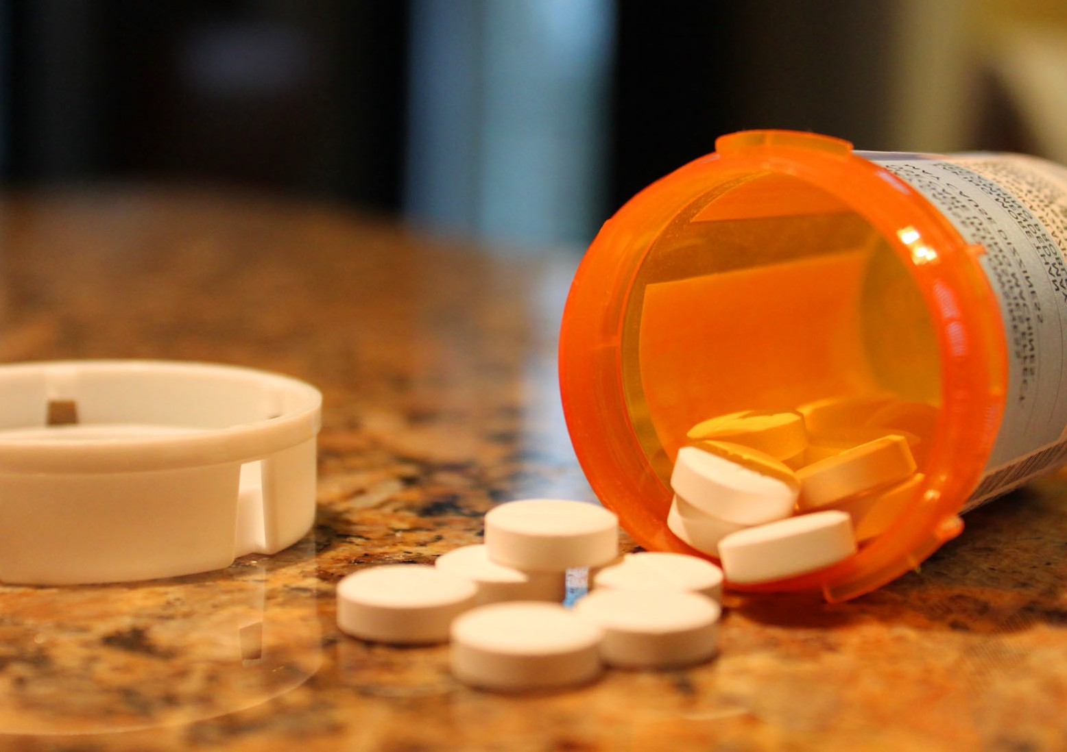
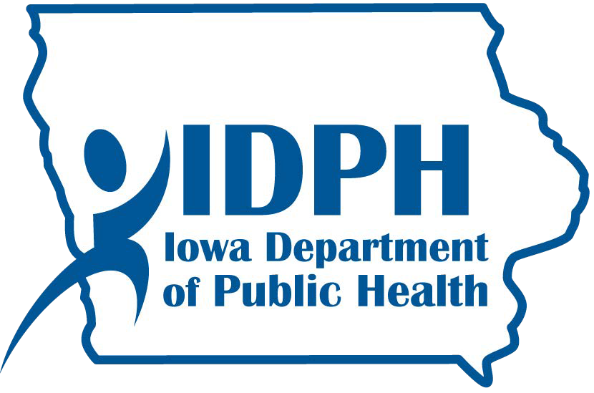
Opioid
Overdose Recognition and Response

Slide 19
State of Iowa Opioids Report Card
Measure | Yes | No
1. State has a Prescription Monitoring Program | ✓
Prescribers are required to use the Prescription Monitoring Program | ✓*
Prescription Monitoring Program has 24-hour upload from pharmacies | ✓*
4. State utilizes prescription limits for opioids |  | X
5. State has a Syringe Services Program |  | X
6. State has a Good Samaritan Law | ✓*
7. State has Expanded Naloxone Access | ✓
8. State has dedicated funding for Naloxone |  | X
State has Medicaid coverage for all forms of medication assisted treatment | ✓
10.State requires training on CDC Guidelines for Managing Chronic Pain | ✓*

Slide 20
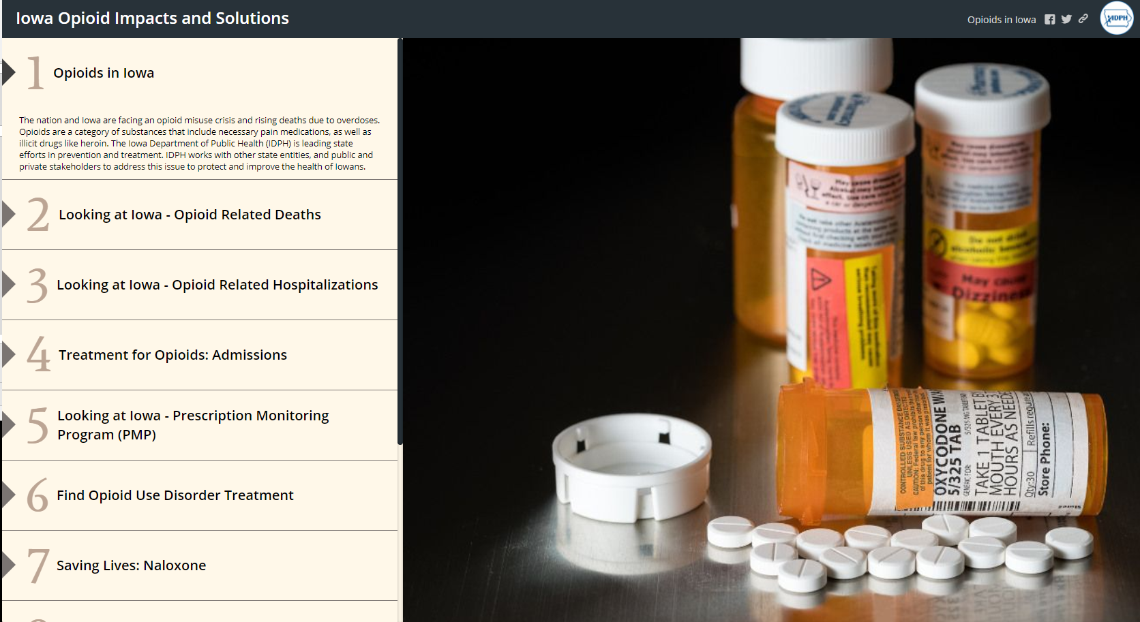

Slide 21
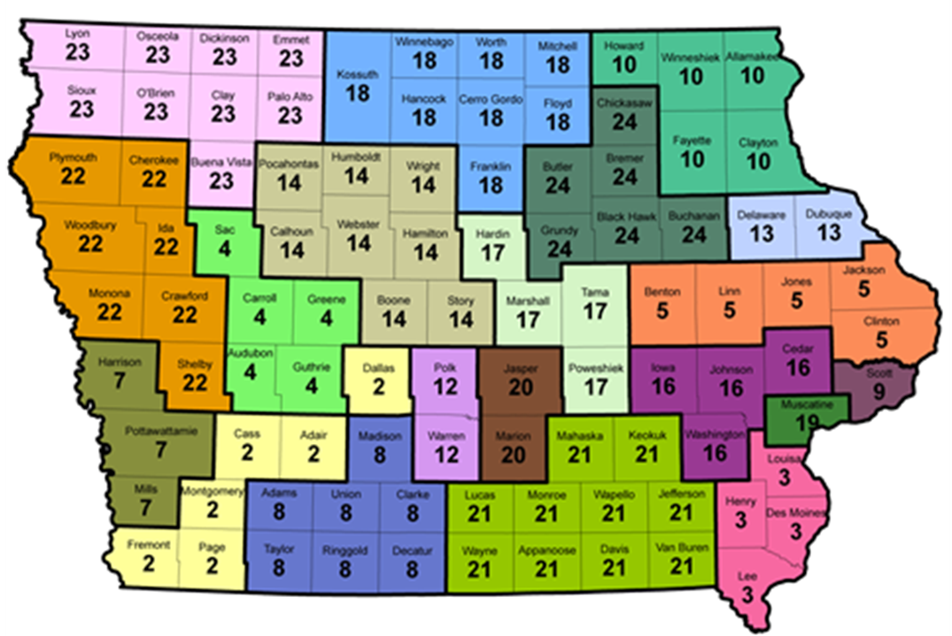

DID YOU KNOW?
Chart, graphic or photos here…
IDPH-funded SUD Treatment services are available across the entire state: click here
Protecting and Improving the Health of Iowans

Slide 22
Questions?

Slide 23

Division of Behavioral Health
Bureau of Substance Abuse
Kevin Gabbert, LISW
kevin.gabbert@idph.iowa.gov
Monica Wilke-Brown, LMSW
monica.wilke-brown@idph.iowa.gov
Protecting and Improving the Health of Iowans

